Slide 1
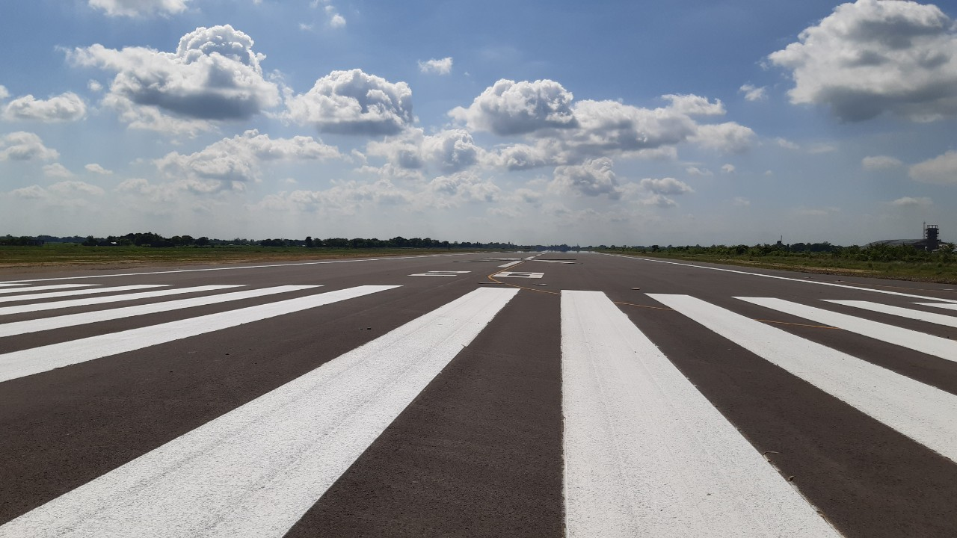
AIRPORTS OF NEPAL & WAY TO GAME CHANGING AIRPORT PROJECT NIJGADH INTERNATIONAL AIRPORT
Presented by:
Eng. PRABESH AHDIKARI
Dy. Manger/Project Chief
Gautam Buddha International Airport Project
Civil Aviation Authority of Nepal

Slide 2
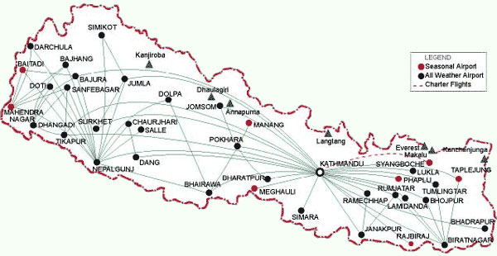
NEPAL PROFILE
Location: Between India and China
Area: 147,516 km²
Population: 29.19 Million
Capital City: Kathmandu
Peoples: 126 caste/ethnic group
Language: 123 reported, Nepali is spoken as mother tongue (44.6%)
Religion(s): 10 (Hindu: 81.3%, Buddhist: 9.04% Islam: 4.4%, Christianity: 1.4%)
Birth place of Lord Buddha
Topography: World’s deepest gorge Kaligandaki to highest point on earth Mt. Everest 8848.86m
E-W length: About 800km
N-S length: 150 to 250km

Slide 3
AIRPORTS OF NEPAL
Formal beginning of aviation in Nepal in 1949
Nepal Attained ICAO membership in 1960
Airports of Nepal
Airports in Operation: 34
Airports not in Operation: 19
Airports under construction
Arghakhachi Airport (STOL)
Pokhara Regional International Airport (4D)
Nijgadh International Airport (4F)
International Airports in Nepal
Tribhuvan International Airport (VNKT), Kathmandu
Gautam Buddha International Airport (VNBW), Bhairahawa (Inaugurated on: 16 May 2022 from Rt. Hon. PM of Nepal)
Pokhara Regional International Airport (Operation from January 2023)
Nijgadh International Airport (Preparation of Updated Master Plan)

Slide 4
TRIBHUVAN INTERNATIONAL AIRPORT

Slide 7
GAUTAM BUDDHA INTERNATIONAL AIRPORT
→ Facts
Airport Code: VNBW
Date of First Services: July 04, 1958
Description | Existing | After upgrading (16 May 2022)
Airport | Domestic | International
Runway | 1500mX30m | 3000mX45m
Apron | 120mX60m | 350mX148m 120mX60m
Terminal Building | 1550 sqm. | 15000 sqm.
Comm. Nav Aid Equipment | VOR/DME | ILS, VOR/DME, Comm. & Met. Equipment

Slide 8
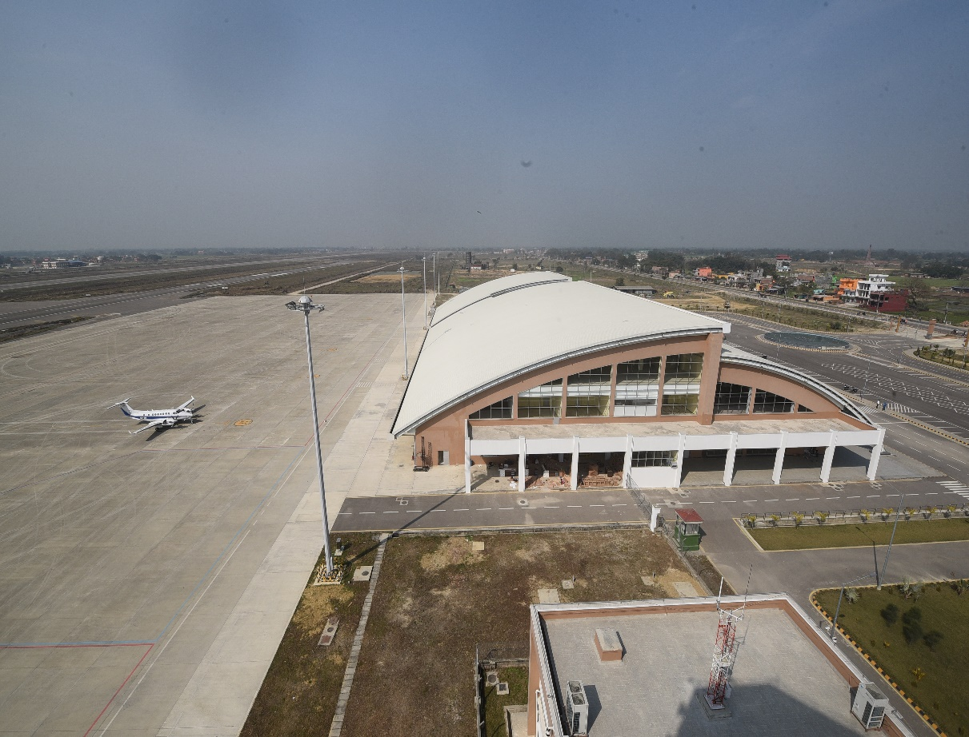
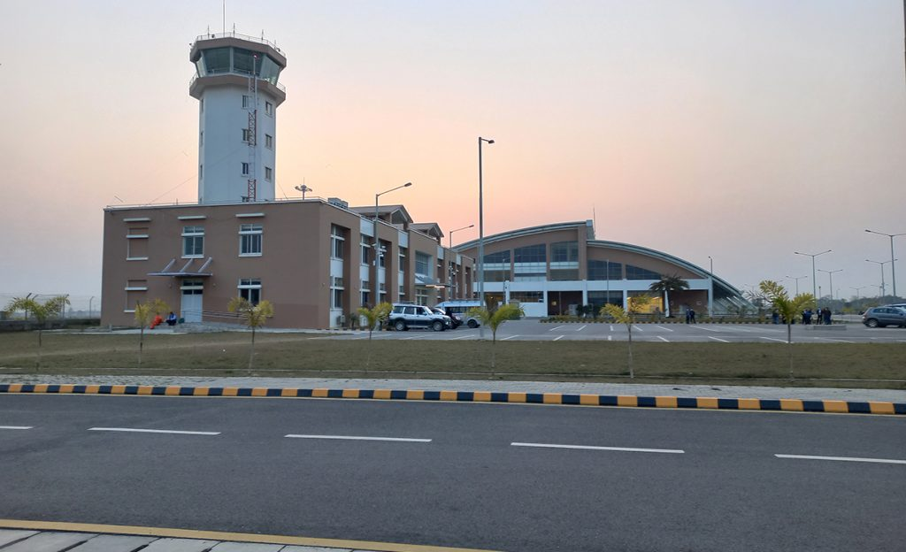

Slide 9
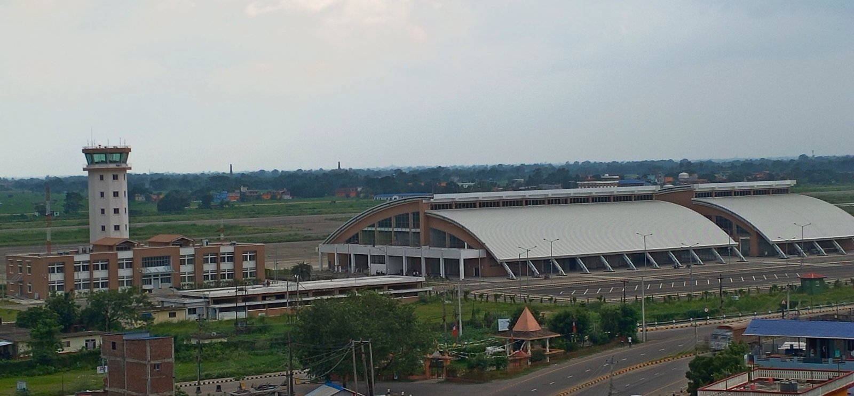
Second international airport of the nation (ICAO 4E Category), in commercial operation from 16 May 2022
Alternative airport for Tribhuvan International Airport Kathmandu (VNKT)

Slide 10
UPDATED MASTER PLAN
The forecasted annual int’l and domestic pax are 0.94 and 0.95 million in 2027, 3.37 and 2.36 million in 2041 respectively.
Planning of new International Terminal Building and other associated works

Slide 11
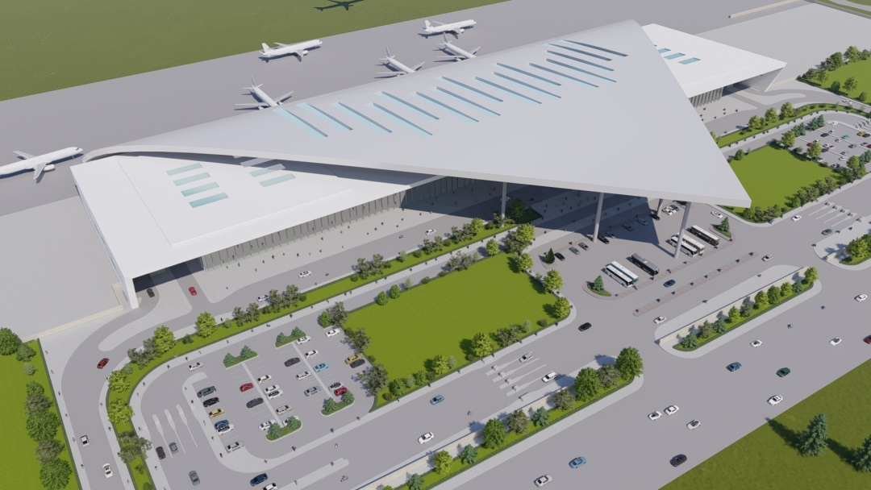
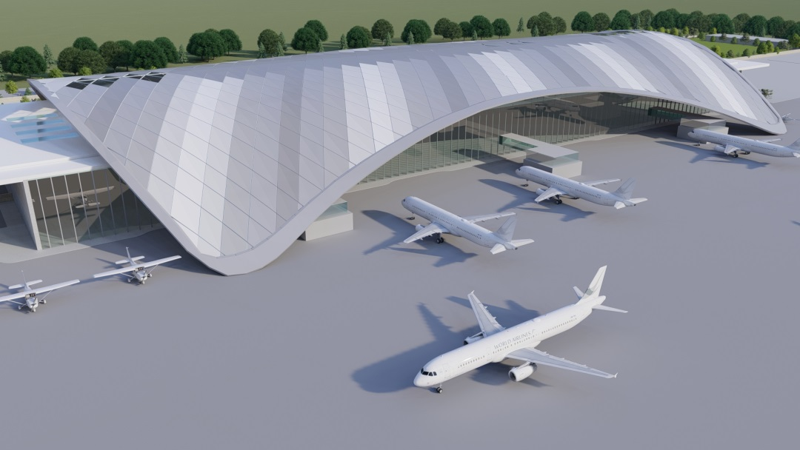
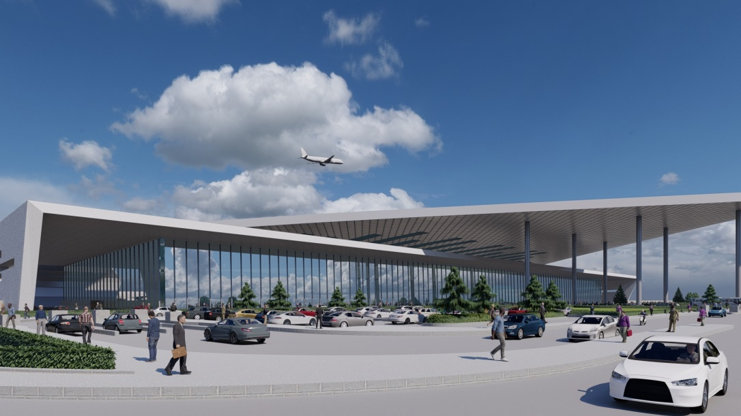
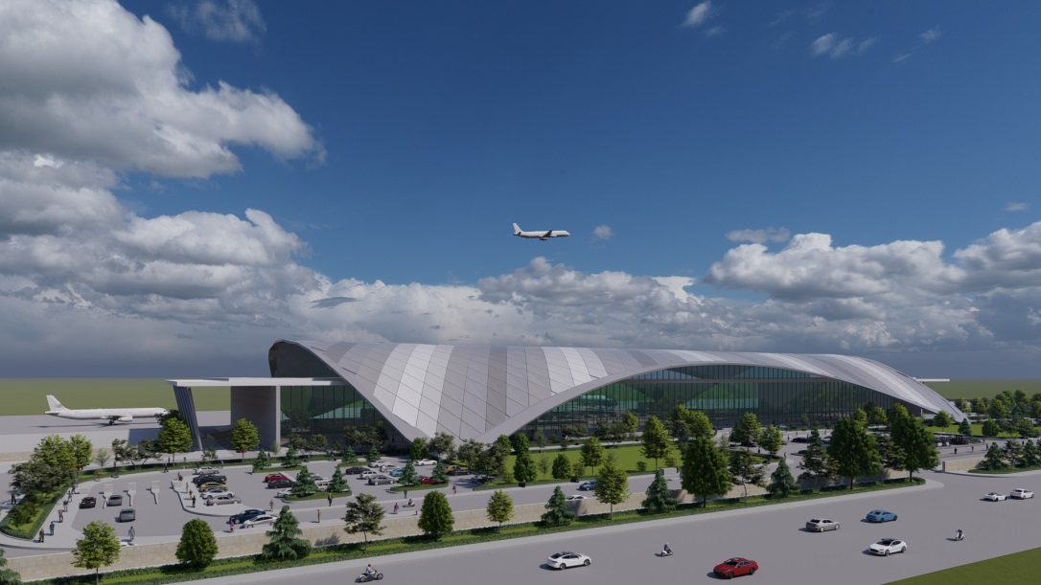
Options Developed for Terminal Building

Slide 12
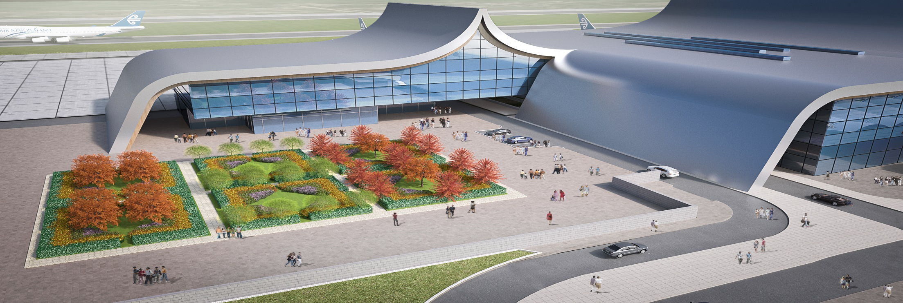
SELECTED OPTION : GAUTAM BUDDHA INTERNATIONAL AIRPORT

Slide 13
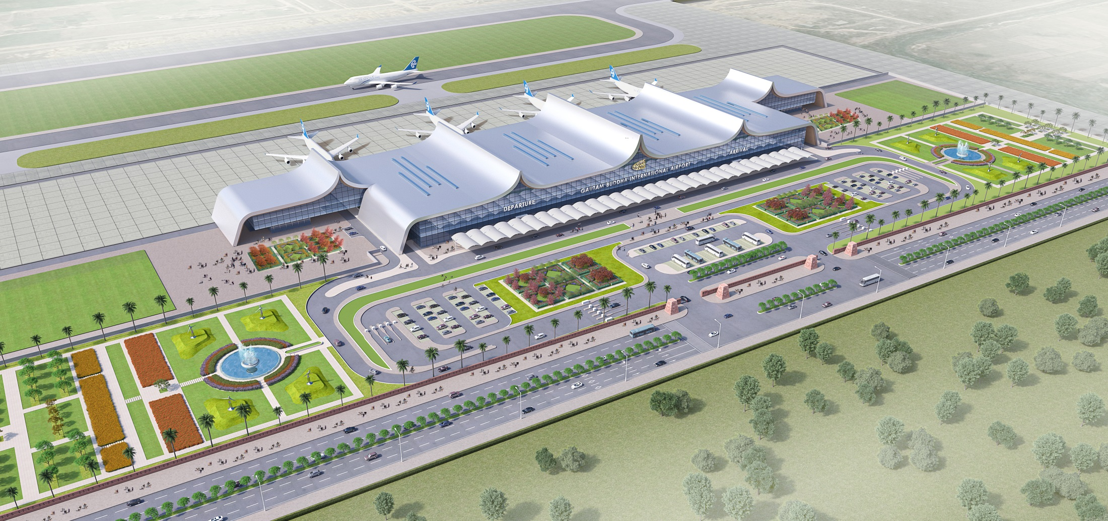
Aerial View (Proposed ITB)

Slide 14
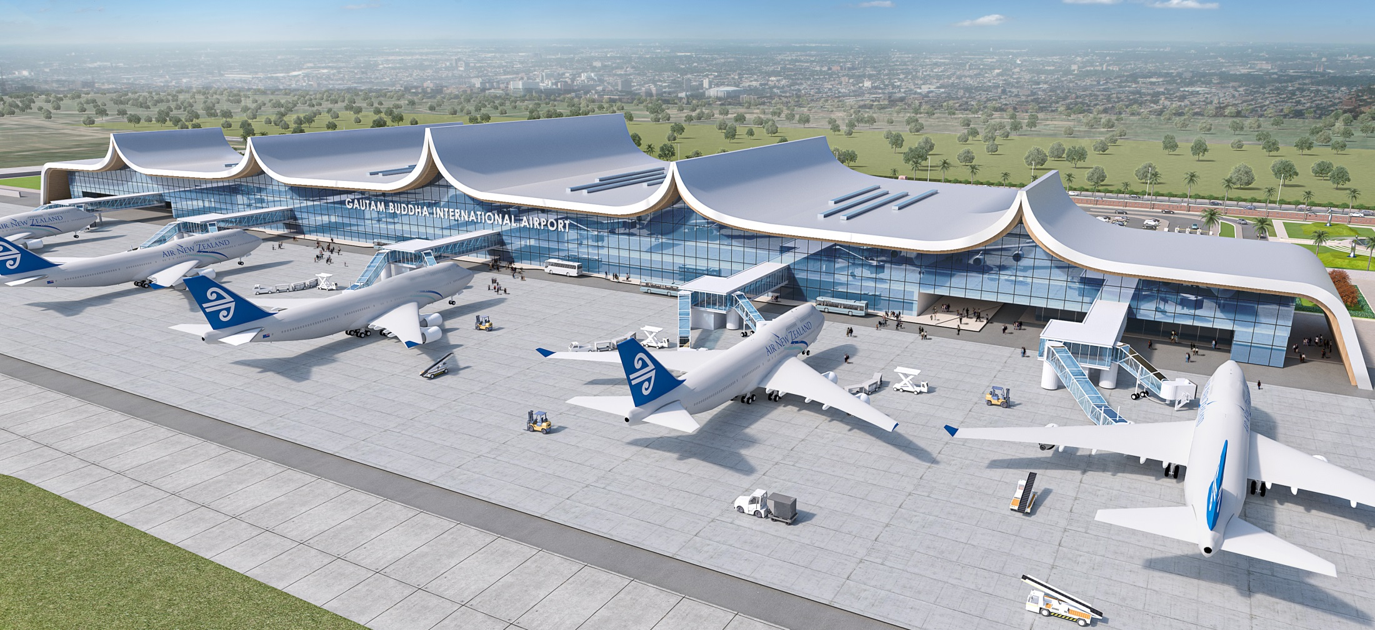
Airside View (Proposed ITB)

Slide 15
POKHARA REGIONAL INTERNATIONAL AIRPORT
Type of Airport : ICAO Category 4D
Runway : 2500m X 45m
Parallel Taxiway : 900 m x 23m
Link Taxiway : 3 Nos.
Apron : 417m X 129m
ITB & DTB : 14643.76 square meter
Hangar : 6055.95 square meter
Approach Light : ILS System precision approach CAT-I
Project is supposed to be completed till December 2022 and will come in to operation after early 2023 (Will be third International Airport of the nation)

Slide 16
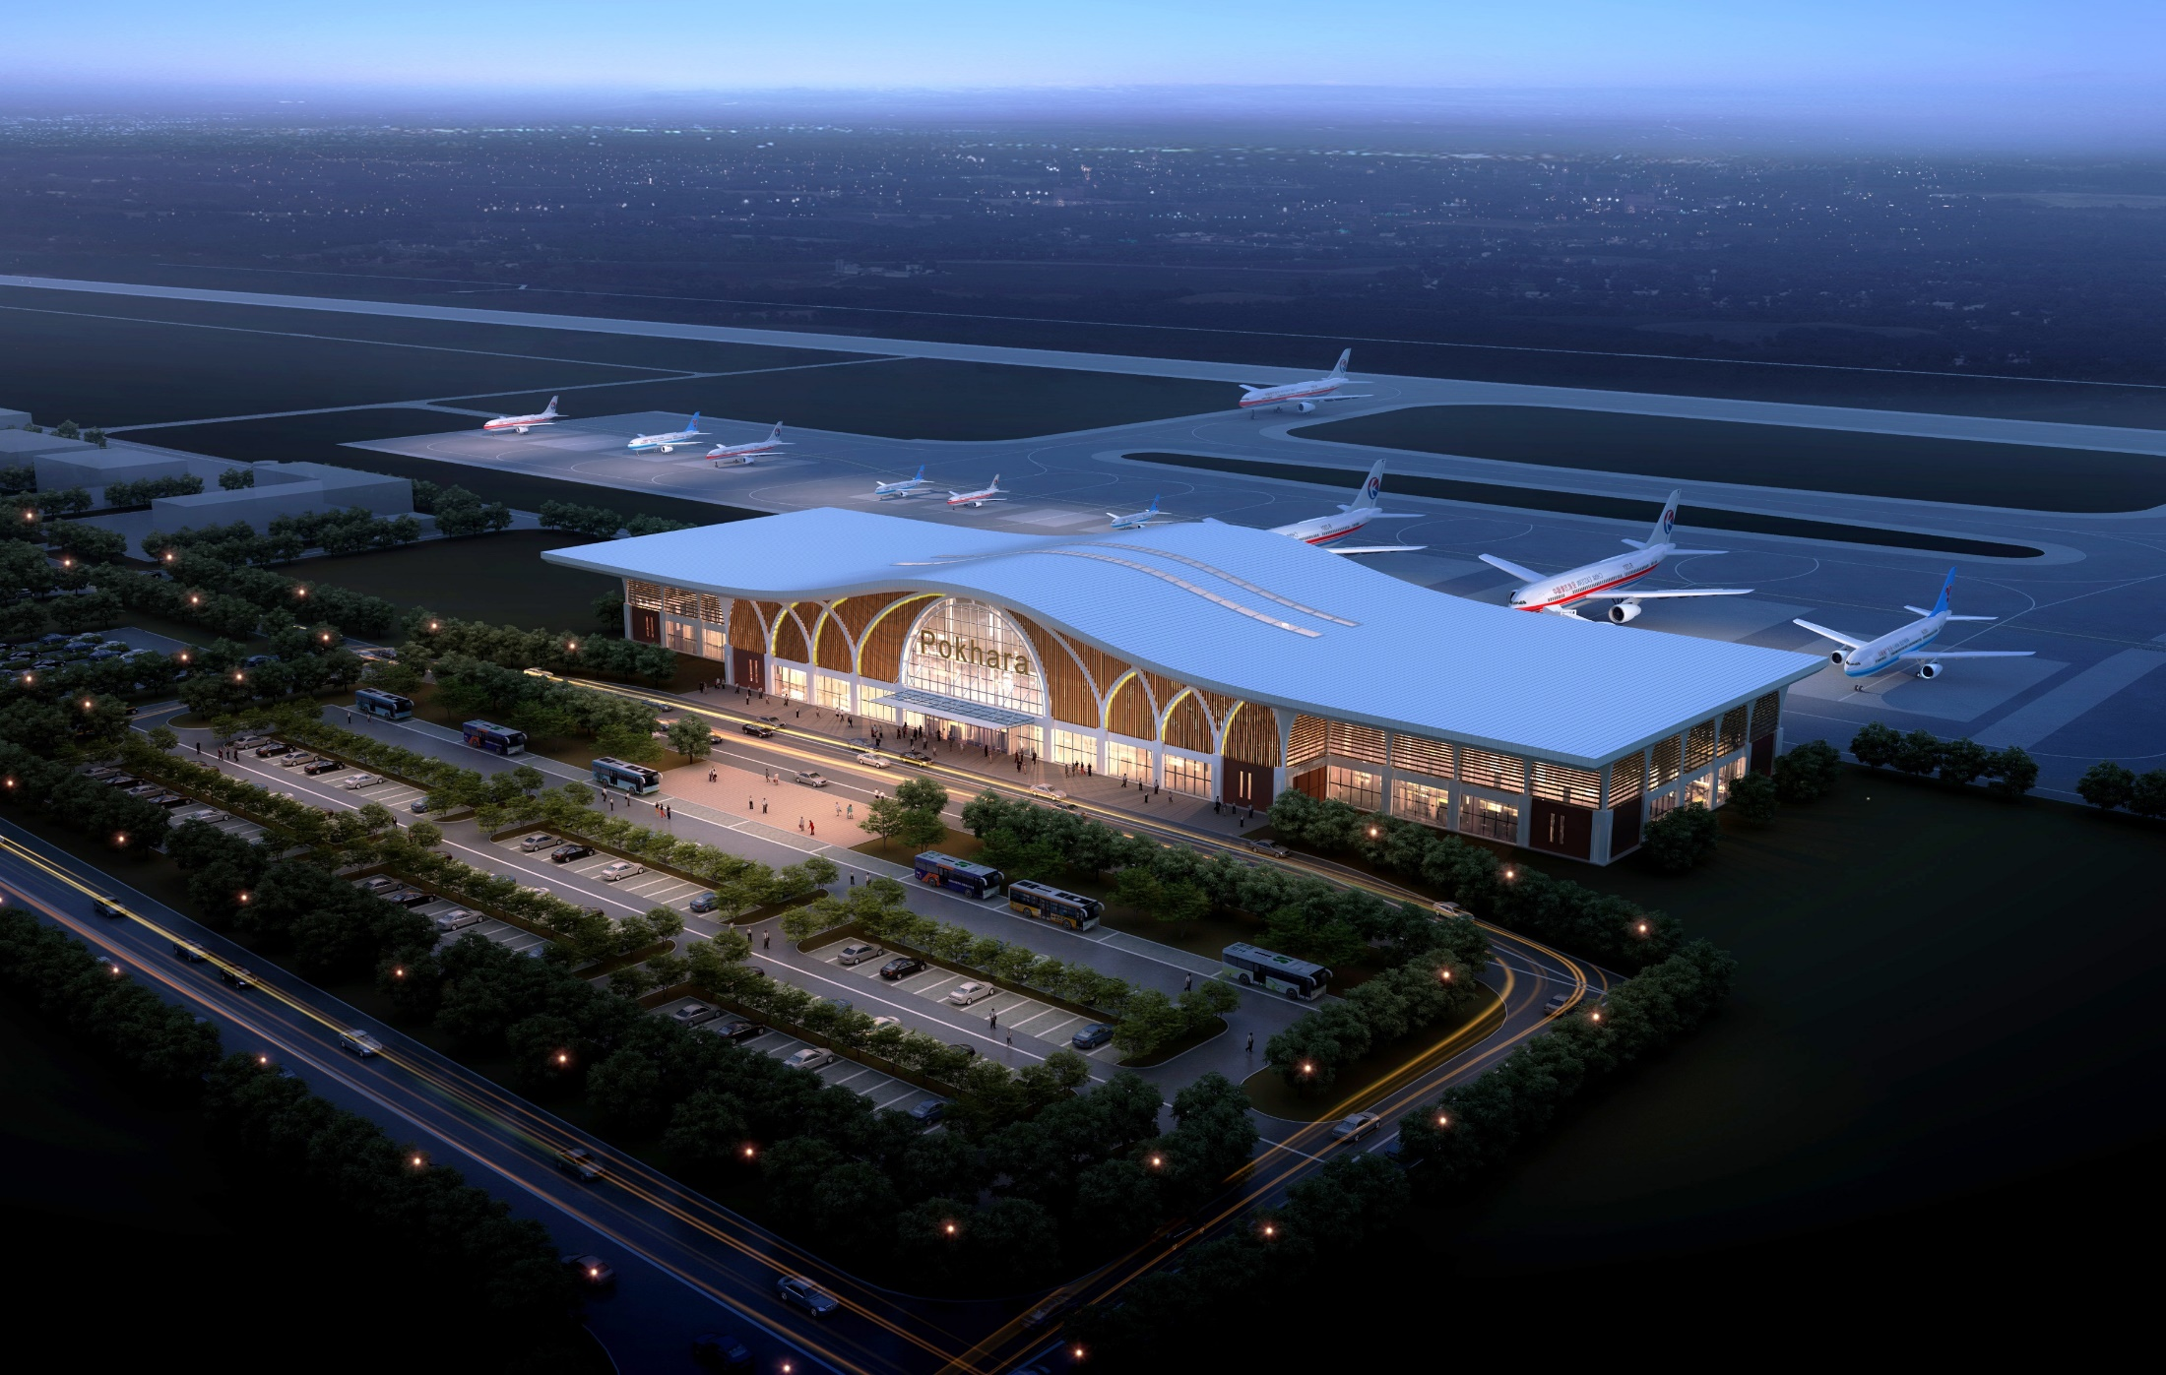
3D View of Terminal and Airfield Area

Slide 17
Aerial View of Runway and Airfield Area

Slide 18
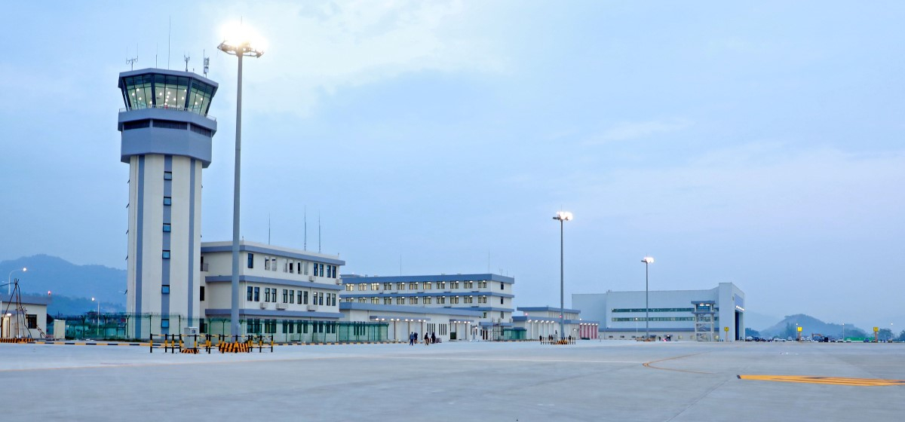
View of Air Traffic Control Tower and Other Buildings

Slide 19
NIJGADH INTERNATIONAL AIRPORT – a game changer project
National Pride Project
Revised master planning phase
Game changer project – Hub Airport
Land Area 8000 Hect. Approx
ICAO Category 4F
Complete greenfield airport with a capacity to cater 150 MPPA, makes the largest of its kinds in the region
4 parallel runways (4500mx60m) – Phased development

Slide 22
Existing site Scenario

Slide 25
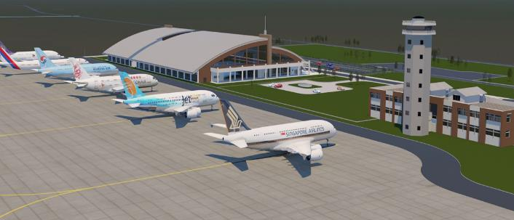
Thank You…

